Slide 1

Cryptocurrency Forecasting and Market Insights
Capstone Project

Slide 2

Abstract and Introduction
Explore the volatile cryptocurrency market through advanced forecasting and analysis.
Utilizing LSTM and SARIMAX models to predict movements of ten major cryptocurrencies.

Slide 3

Project Objectives and Scope
Objective: To develop predictive models for strategic investment insights.
Scope: Analysis covers Bitcoin, Ethereum, Ripple, and other major cryptocurrencies.

Slide 4
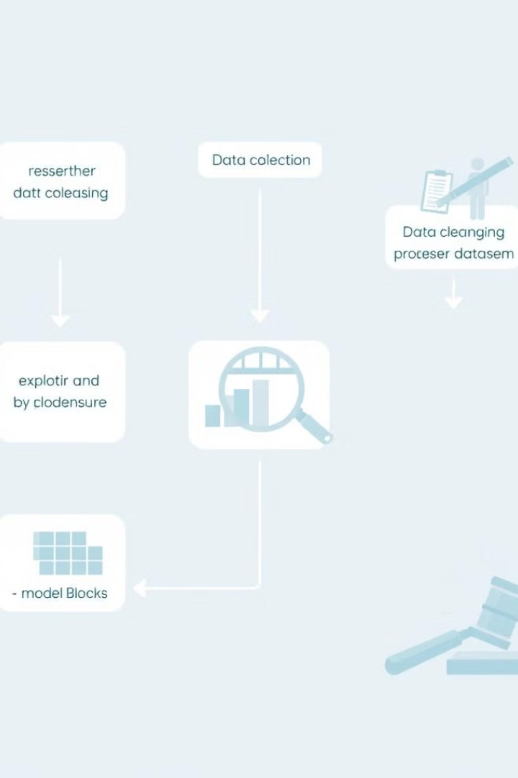
Methodology Overview
A flowchart showing the process from data collection to model evaluation.
Data Collection: Over 7,000 time-series records analyzed.
Data Preprocessing: Extensive cleaning and feature engineering.
Model Development: Application of LSTM and SARIMAX models.

Slide 5

Data Loading and Cleaning
Imported dataset from CSV: 7,200 observations, reduced to 7,070 after cleaning.
Timestamps converted for accurate time-series analysis.
Impact: Ensured high-quality, consistent data ready for multi-dimensional analysis.

Slide 6
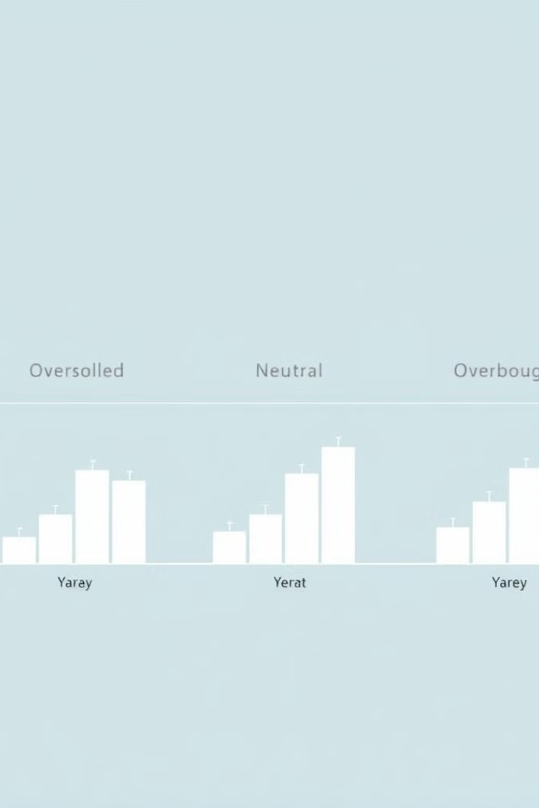
RSI Zone vs Price Change Analysis
Boxplots showing price changes across RSI categories.
RSI values categorized into Oversold, Neutral, Overbought.
Boxplots illustrate how different RSI zones correlate with price changes.
Insight: Identified potential buying opportunities in oversold conditions.

Slide 7

Volume Spike vs Price Change Analysis
Defined volume spikes using the 90th percentile.
Compared price changes during spikes to normal days.
Finding: Significant volume spikes correlate with major market events and price fluctuations.

Slide 8
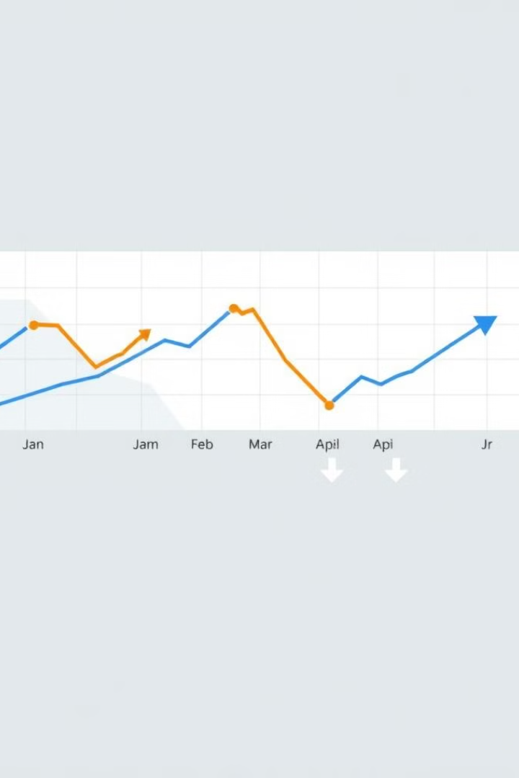
MACD Crossover Analysis
Tracked MACD crossovers as potential bullish signals.
Analyzed price changes following crossovers.
Result: Validated MACD as a useful predictor of short-term price movements.

Slide 9
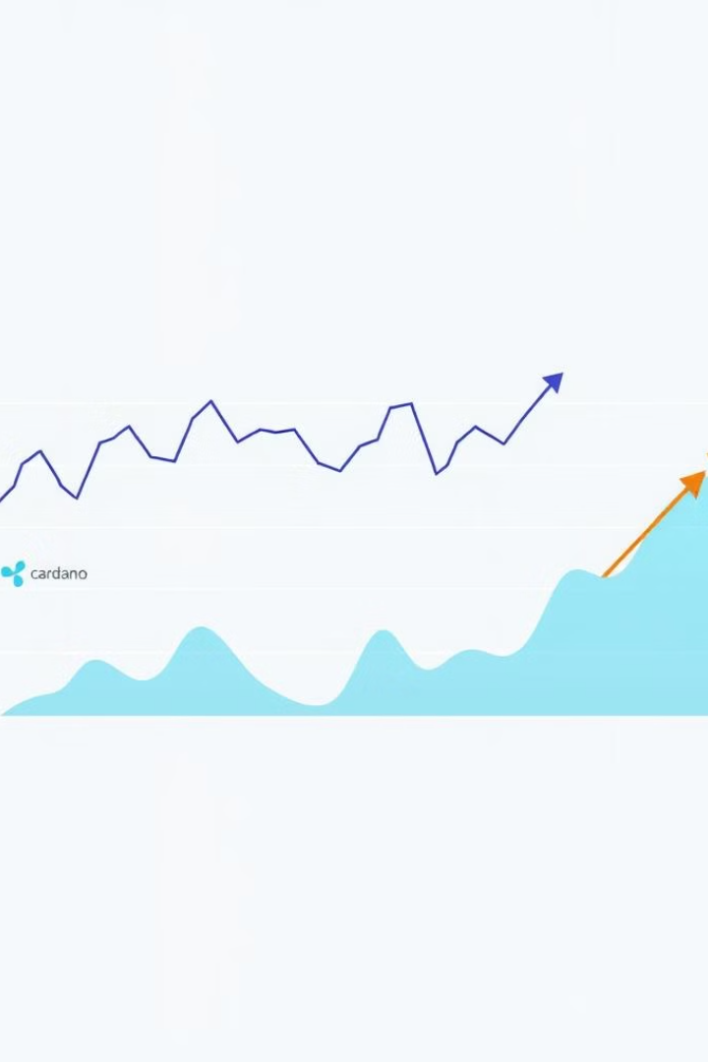
Weekly Trend Analysis
Focused on specific cryptocurrencies like Cardano and Ripple.
Analyzed average daily price changes by day of the week.
Insight: Detected patterns that could influence weekly trading strategies.

Slide 10

Final Reflection and Future Directions
Summarized the project's key insights and their impact on cryptocurrency trading strategies.
Future Directions: Explore further predictive modeling enhancements and real-time data integration.

